Slide 1
Ukraine-France Forum
Yuriy Vitrenko
CEO of NAFTOGAZ
10 February 2022

Slide 2
Неринкові дії Газпрому мають вирішальний вплив на ринок
The energy crisis in Europe: prices up, supplies down
1
Gazprom's refusal to reserve additional capacity
Dynamics of the spot index TTF, euro/MWh
2
4
Positive opinion of the Ministry
of Economy of Germany
on the certification of “NS-2"
+141 (+341%)
3
3
Gazprom's refusal to reserve Yamal-Europe facilities
5
1
4
Redirection of LNG tankers
to Europe
1
2
+26 (+221%)
5
Growth of transit
through Ukraine
Fundamental reasons
Geopolitical reasons
01/20
03/20
05/20
07/20
09/20
11/20
01/21
03/21
05/21
07/21
09/21
11/21
01/22
Source: Argus, Bloomberg

Slide 3
The energy crisis in Europe: prices up, supplies down
Transit through Ukraine, bcm
Total Gazprom’s transit to Europe, bcm
9,0
18,5
8,5
18,0
8,0
8,0
8,0
17,5
17,1
17,1
-41,7 (-22%)
-11,0 (-7%)
7,4
7,4
-46,3 (-53%)
-14,2 (-25%)
17,0
16,6
7,5
7,3
7,2
7,2
7,2
7,3
7,3
7,2
16,5
16,3
16,2
7,0
16,0
15,9
16,0
6,5
6,5
15,5
15,4
15,2
15,0
15,0
15,0
6,0
5,5
5,7
14,5
14,3
5,5
5,3
88,0
14,0
13,8
13,6
13,8
190,1
5,0
5,0
4,9
13,5
159,4
148,4
4,6
4,6
4,7
4,7
13,1
13,1
4,5
4,4
55,9
41,7
13,0
12,7
4,0
3,9
3,9
3,7
3,7
3,9
3,7
3,9
3,8
-52%
12,5
11,9
12,2
12,0
11,7
11,5
3,5
3,3
3,0
3,2
2016-2019
average
2020
2021
11,5
2016-2019
average
2020
2021
3,0
2,9
11,0
2,5
2,6
10,5
10,4
0,0
Jan
Feb
Mar
Apr
May
Jun
Jul
Aug
Sept
Oct
Nov
Dec
0,0
Jan
Feb
Mar
Apr
Тра
Jun
Jul
Aug
Sept
Oct
Nov
Dec
Average 2016-2019
2020
2021
min-max (2016-2019)

Slide 4
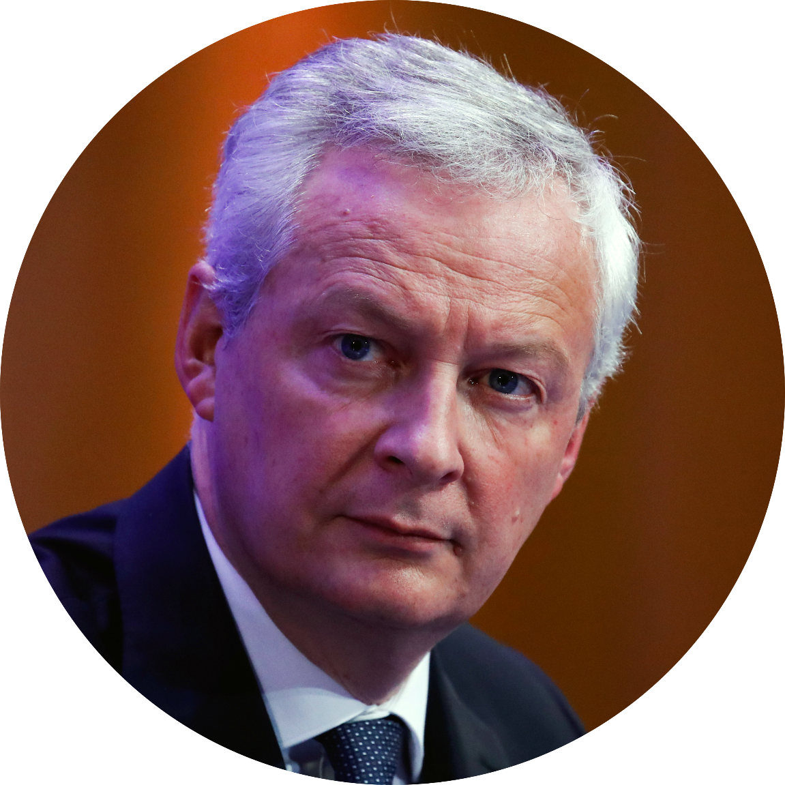
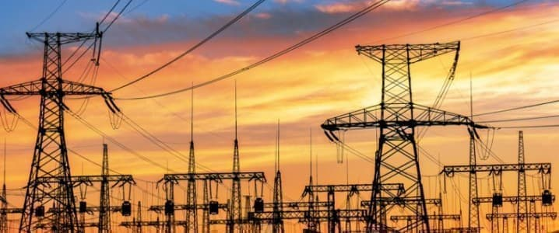
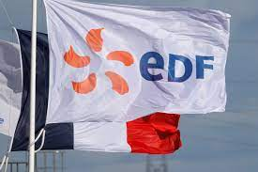
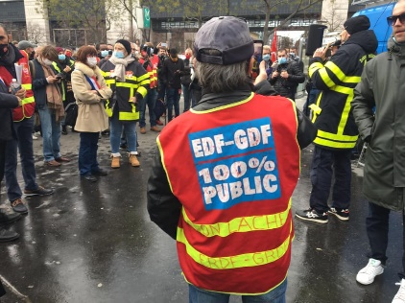
France in the energy crisis
Regulated gas prices went up by 12.6% in October 2021 and have been frozen until June 2022.
Electricity prices increased by 4% in 2021.
5.8 million lower-income households received a €100 "chèque énergie" in December 2021.
Economy Minister
Bruno Le Maire:
if we had not intervened,
prices would be going up
by a whopping 45%
***According to service-public.fr

Slide 5
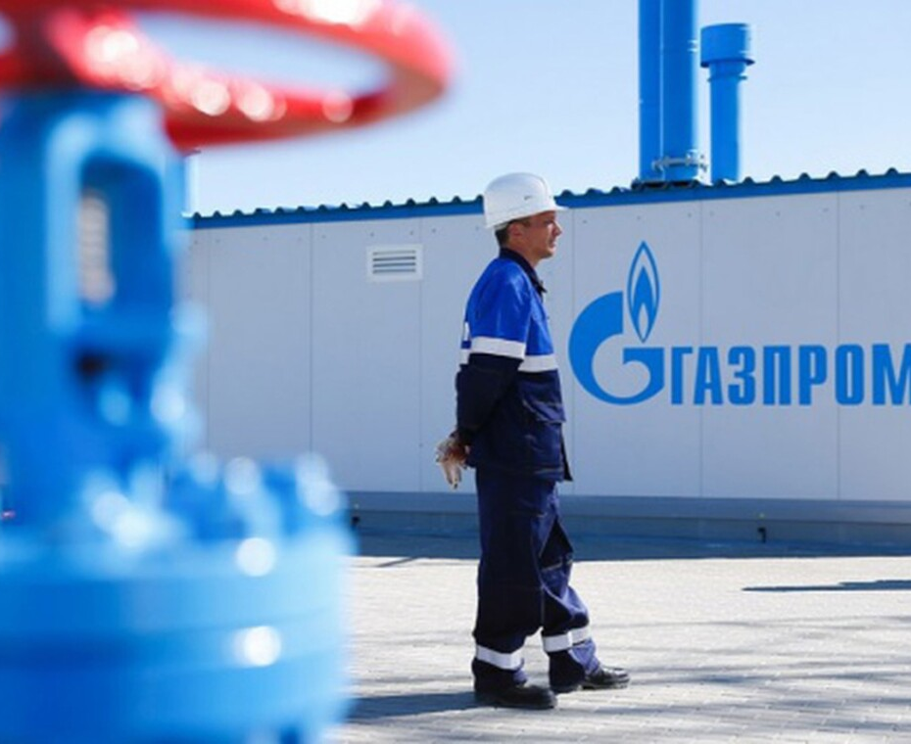
How did we get here?
The EU market is liberalized, and Russia is allowed to participate in it
EU rules do not apply to Gazprom
Transit through the territory of Ukraine blocked by Gazprom for: EU, other Russian and Central Asian companies

Slide 6
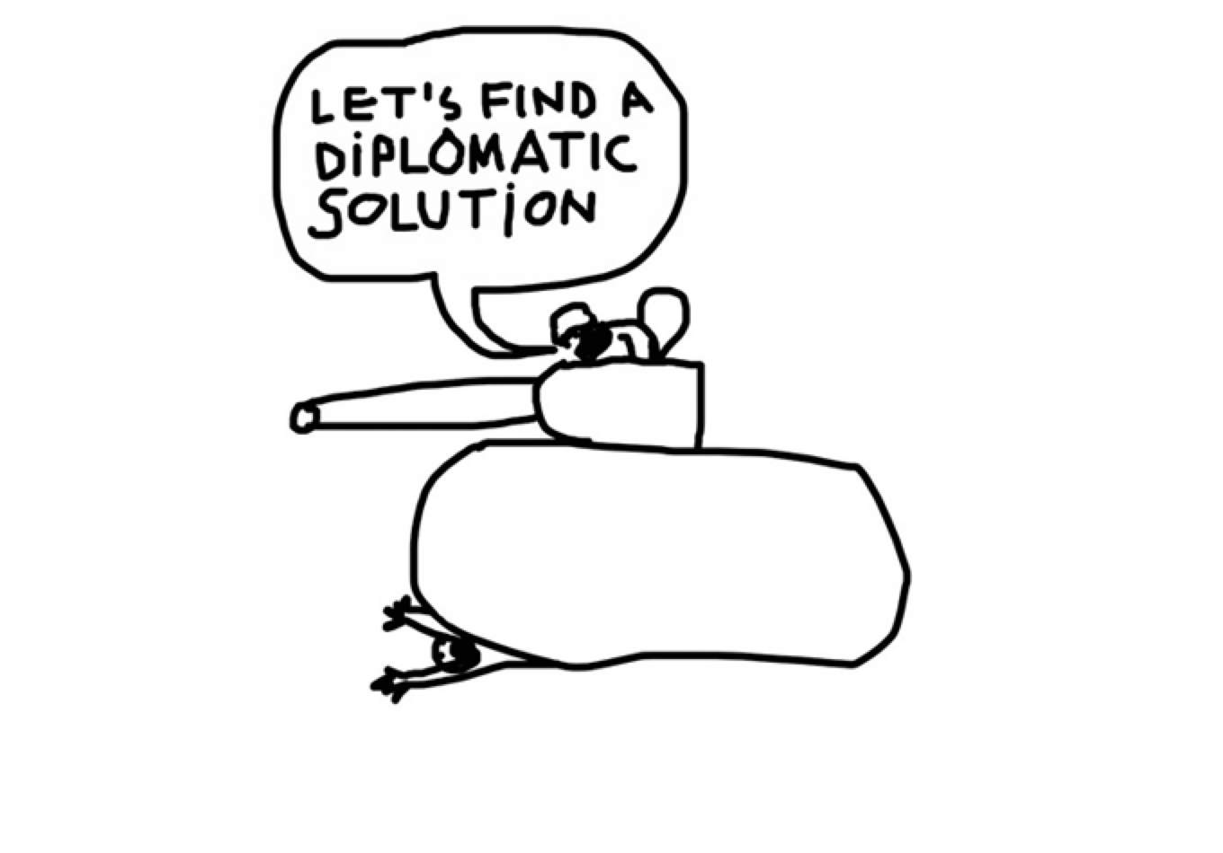
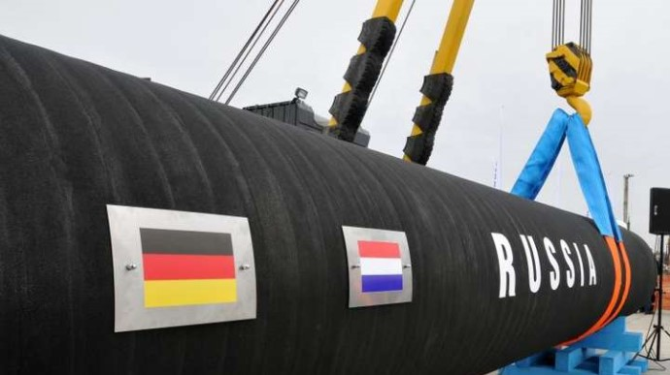
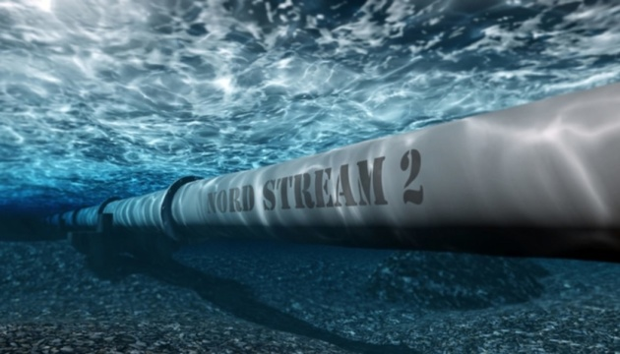
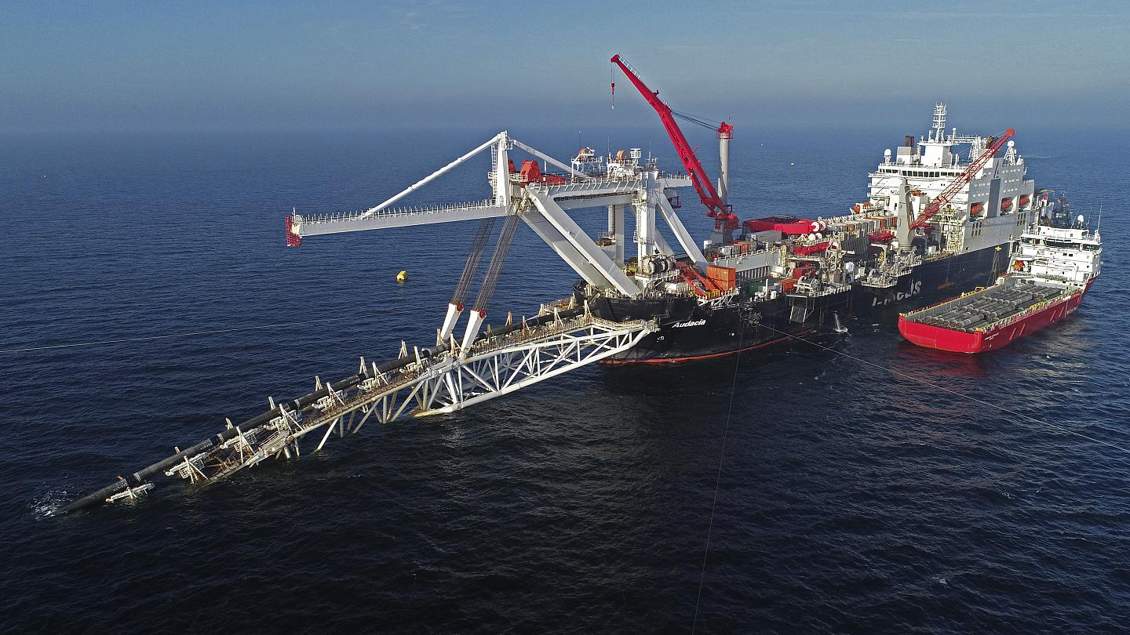
What does Putin want?
Nord Stream-2 operates despite non-compliance with EU law
The EU is again bound by long-term contracts

Slide 7
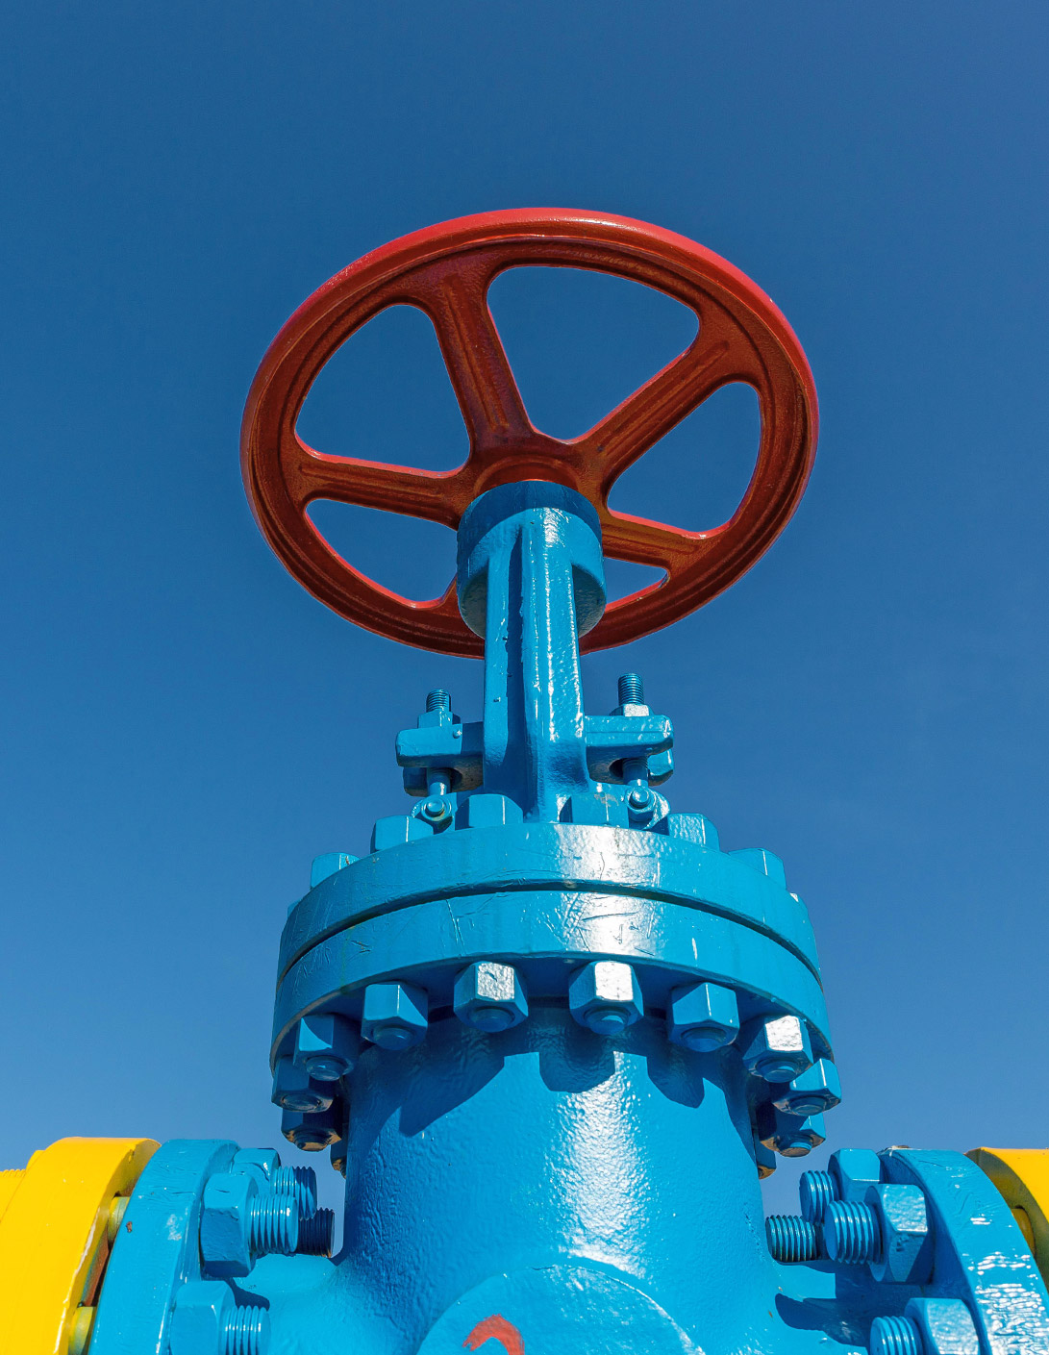
What can be done?
1
2
3
4
5
Investigate the energy market manipulation
Make sure that NS2 is not operational unless it is compliant with the EU regulation
Keep gas transit through Ukraine as one of the routes
New European policy: gas storage solution that cushion against Russian cut-offs
Fight back against Russian disinformation on NS2

Slide 8
Thank you
+380 (44) 586-3330
ngu@naftogaz.com
naftogaz.com

